Slide 1
Daily routine
5th grade A & B
Miss Claudia Matus
Mister Deni Segura

Slide 2
What is daily routine?

Slide 3
Daily routine actions

Slide 4
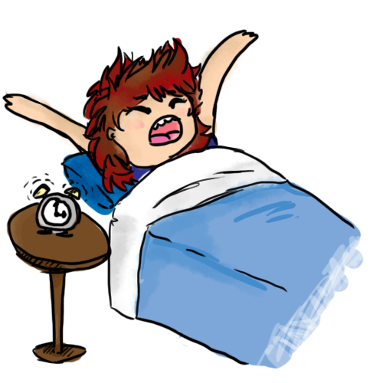
I wake up

Slide 5
I get up

Slide 6
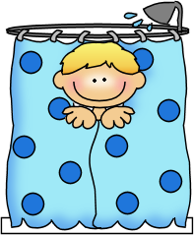
I take a shower

Slide 7
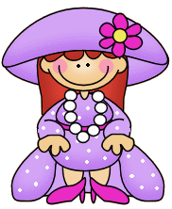
I get dressed

Slide 8
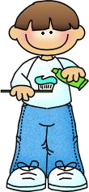
I brush my teeth

Slide 9
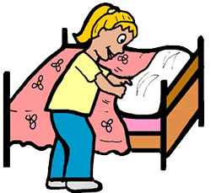
I make my bed

Slide 10
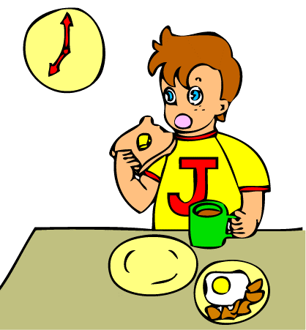
I have breakfast

Slide 11
I go to school

Slide 12
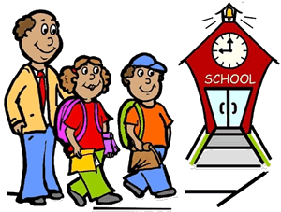
I walk to school

Slide 13
I have lunch

Slide 14
I do the homework

Slide 15
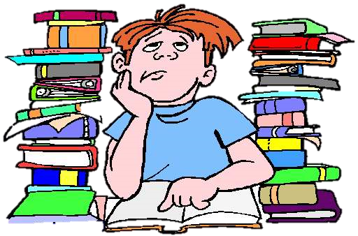
I study

Slide 16
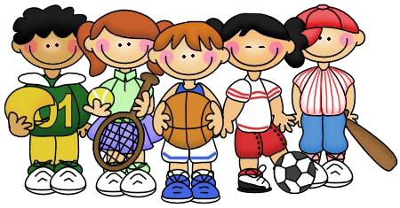
I play with my friends

Slide 17
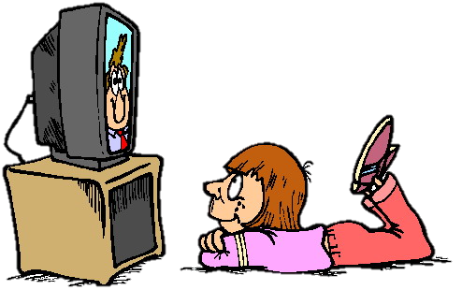
I watch TV

Slide 18
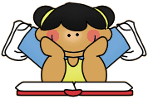
I read a book

Slide 19
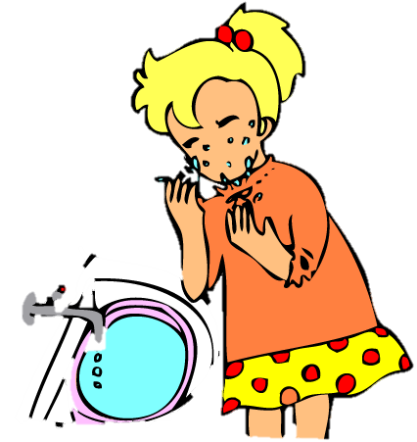
I wash my hands and face

Slide 20
I go to bed

Slide 21
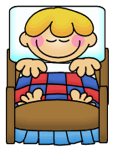
I sleep

Slide 22
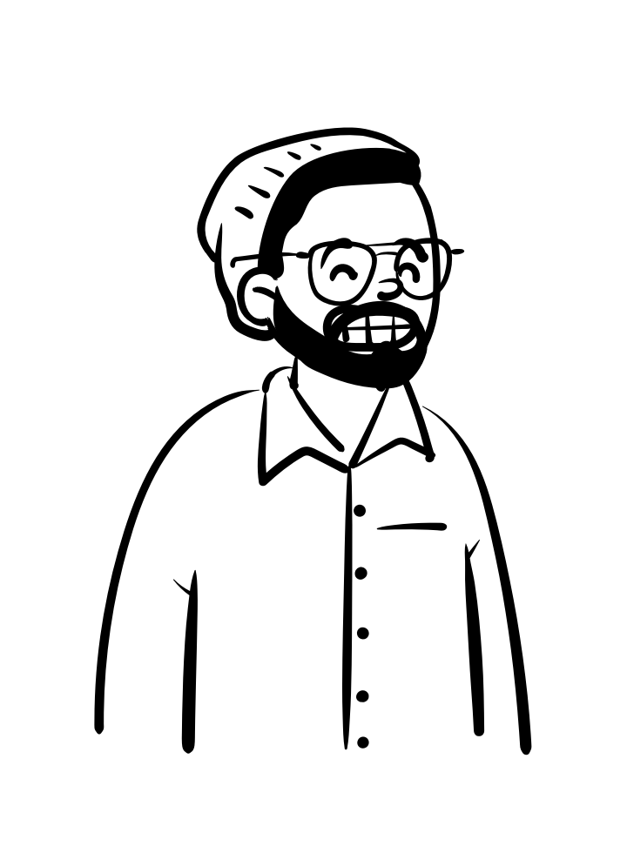
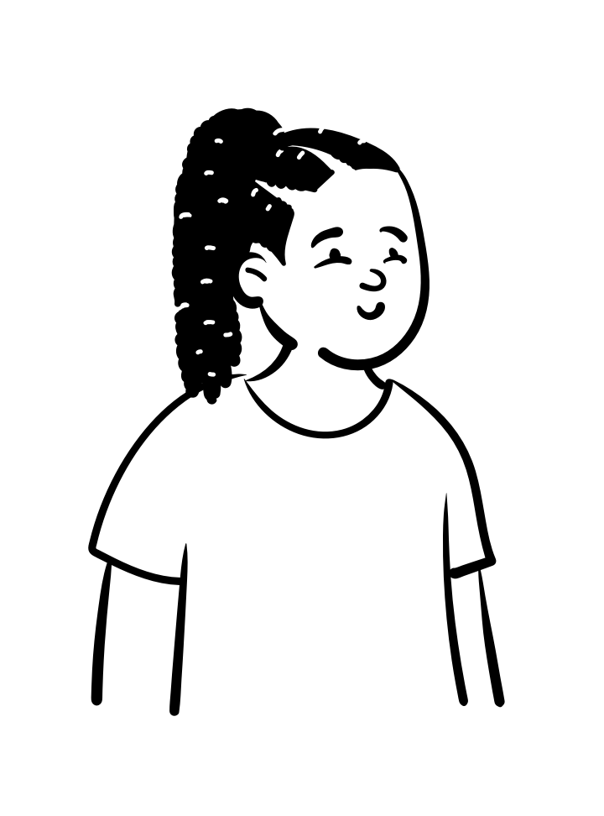
Well doneee!
See you soon!

