Slide 1
ARTES VISUALES 8
BLANCA MERI MEDINA

Slide 2
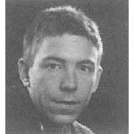
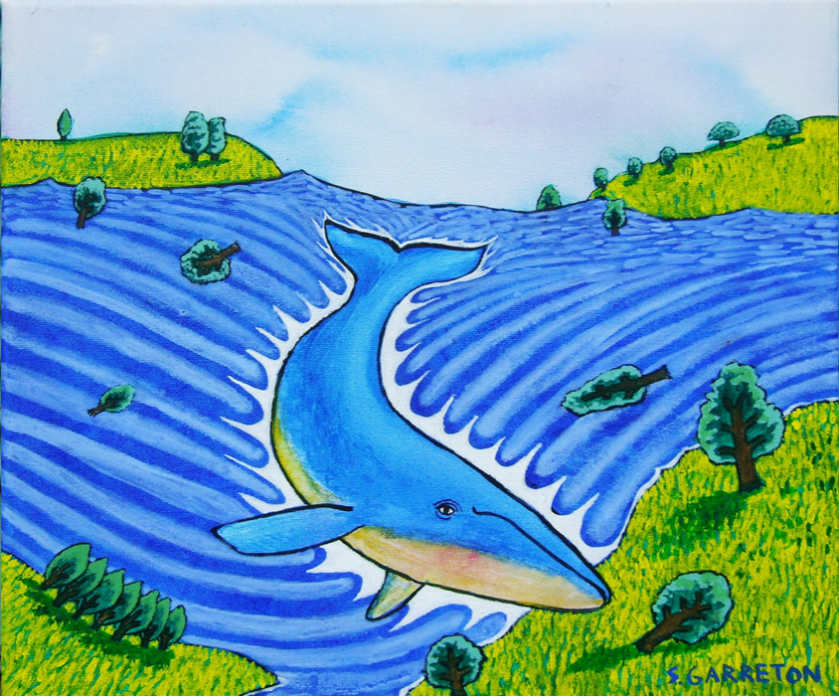
REALIZAR UN LAPBOOK SOBRE ARTISTAS NACIONALES DE PAISAJE URBANO
T
SEBASTIAN GARRETÓN

Slide 3
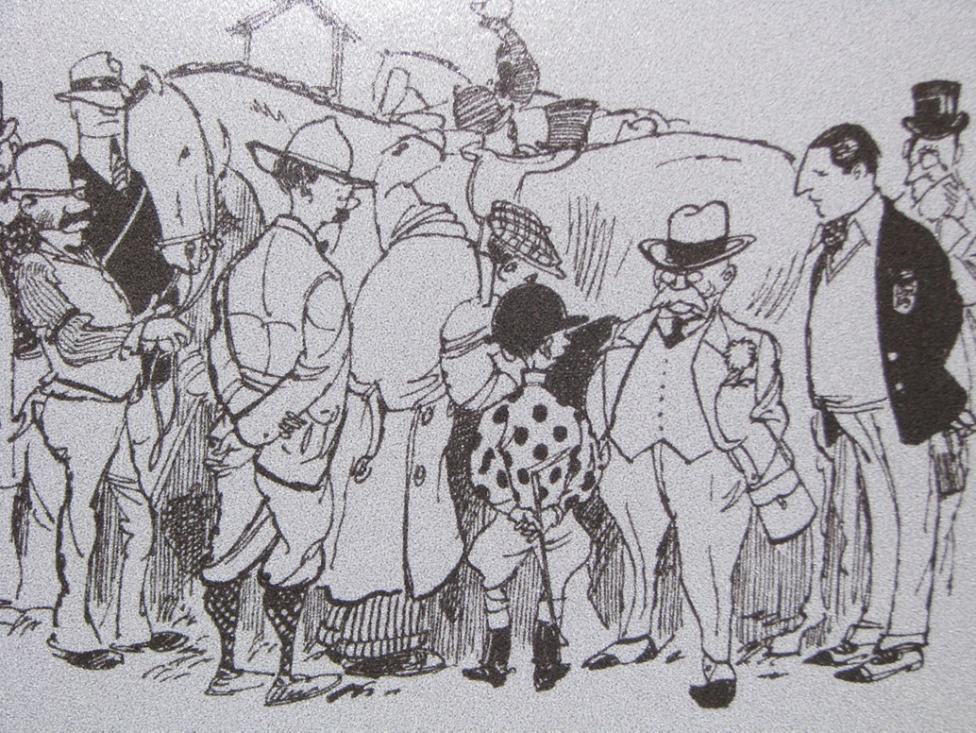
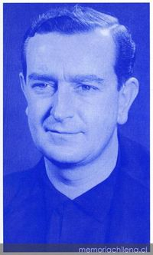
LUKAS .RENZO PECHENINO RAGI
Objectives inform students the learning outcomes of the class. What will they know? What will they be able to do? Why is this important to know? It's an effective way to assess their learning progress.

Slide 4
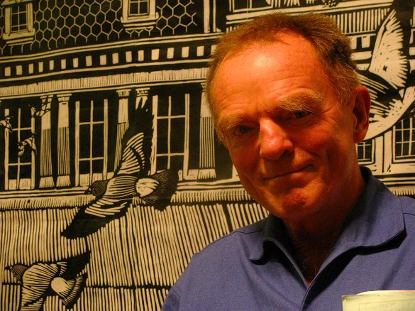
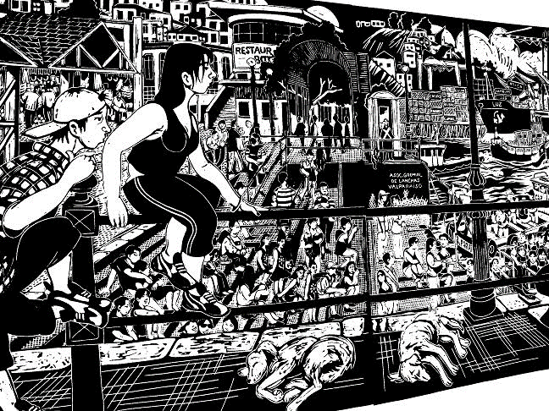
LORO COIRÓN

Slide 5
TAREA.
HAGO UN LAPBOOK DE UNO DE ESTOS ARTISTAS,Y ME LO
ENVÍAS AL CORREO
BMEDINA@COLEGIOSANNICOLAS.CL
Add instructions or guidelines here. You can also put additional details on when and how to submit.

